Slide 1



Energy Consumption Trend Analysis
Name:- Om Pramod Kolamkar
AICTE ID:- STU67dfb6c5ef1c41742714565
Reference:- https://github.com/Omkolamkar/Energy-Consumption-Week-3

Slide 2

Learning Objectives
Understand the importance of tracking energy usage patterns over time.
Learn how to use Power BI to develop interactive, real-time dashboards.
Gain insight into data transformation, modeling, and visualization techniques.
Identify trends in electricity, water, and gas consumption across multiple weeks.
Develop the ability to present energy insights to stakeholders for informed decision-making.
Promote sustainable practices through data-driven recommendations.
GOAL
Source :
www.freepik.com/

Slide 3
Goal:
The goal of this project is to analyze and monitor weekly trends in energy consumption—specifically focusing on electricity, water, and gas usage—across various facilities or buildings. With the increasing demand for sustainability and cost control, it's essential to have a data-driven approach to identify consumption patterns, anomalies, and peak usage periods.
By utilizing Microsoft Power BI, this project aims to:
Convert raw energy data into structured insights.
Visualize weekly variations in resource consumption.
Enable stakeholders to make informed decisions about energy efficiency.
Support cost-saving measures by revealing inefficiencies and overutilization.
Lay the groundwork for sustainable resource management in both public and private sectors.

Slide 4
Tools and Technology used
Microsoft Power BI: For creating dynamic and interactive dashboards.
Microsoft Excel: Used for collecting and cleaning raw energy consumption data.
DAX (Data Analysis Expressions): Applied for complex calculations and aggregations.
Power Query: Used for transforming and shaping the dataset before visualization.
Data Modeling: Establishing relationships between data tables to enable analysis.
Charts & Visual Tools: Line graphs, bar charts, KPIs, slicers, and filters.

Slide 5
Methodology
Data Collection: Energy usage data was collected in Excel format for different buildings across multiple weeks.
Data Cleaning: In Power BI, inconsistencies and missing values were addressed using Power Query.
Data Modeling: Tables were linked logically using relationships (e.g., Date table, Building Master).
Dashboard Development: Multiple visuals (KPIs, line charts, bar graphs) were built to analyze weekly consumption trends.
Trend Analysis: Consumption was segmented by resource type (electricity, gas, water) and time frame to uncover patterns.
Insight Generation: Key findings were derived to recommend strategies for reducing energy usage and costs.

Slide 6
Problem Statement:
In today’s fast-paced industrial and urban environments, energy consumption is rapidly increasing, which directly contributes to rising operational costs and environmental degradation through excessive carbon emissions. Despite the availability of data, many organizations lack the tools, expertise, or systems to understand where, when, and how energy is being consumed inefficiently.
This lack of visibility often results in:
Wastage of critical resources like electricity, gas, and water.
Inability to detect unusual spikes or leakage in consumption.
Difficulty in enforcing sustainability policies or energy audits.
Missed opportunities to cut energy costs and emissions.
A strategic solution is needed that transforms data into actionable insights, enabling timely decisions and long-term impact.

Slide 7
Solution:
To address the issue, an interactive and intelligent Power BI dashboard was developed, designed to:
Track and visualize weekly energy usage trends across multiple buildings and resource types.
Provide easy-to-read charts, KPIs, and filters to compare electricity, water, and gas consumption.
Enable users to identify peak usage weeks, high-consuming buildings, and seasonal patterns.
Deliver real-time and historical views for improved decision-making.
This solution empowers users with a centralized visual system that simplifies complex energy datasets, promotes transparency, and encourages accountability. Ultimately, the dashboard serves as a strategic decision-support tool for resource planning, sustainability, and cost control.

Slide 8
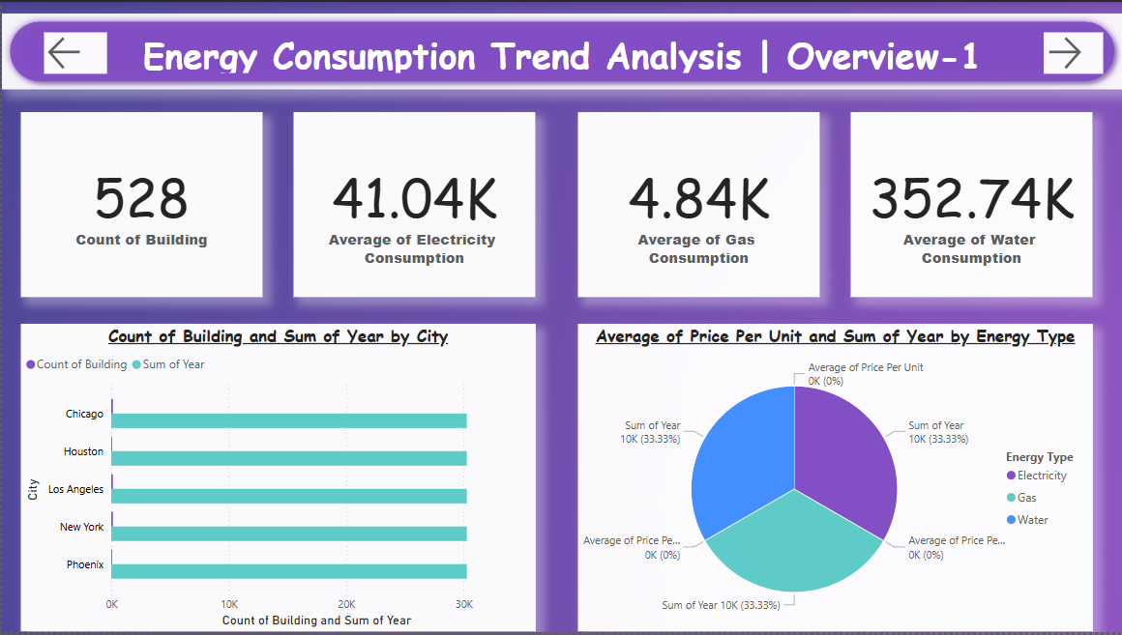
Screenshot of Output: 1) Energy Consumption Trend Analysis | Overview-1
KPI Cards:
Count of Buildings: 528
Average Electricity Consumption: 41.04K
Average Gas Consumption: 4.84K
Average Water Consumption: 352.74K
Bar Chart: Count of Buildings and Sum of Year by City:
Compares five cities (Chicago, Houston, Los Angeles, New York, Phoenix)
Each city has roughly similar building counts and yearly consumption totals
Pie Chart: Average Price Per Unit and Sum of Year by Energy Type:
Shows proportion of energy types (Electricity, Gas, Water)
Each type has 33.33% of yearly sum, and average price per unit is marked as 0K (likely due to missing or normalized values)

Slide 9
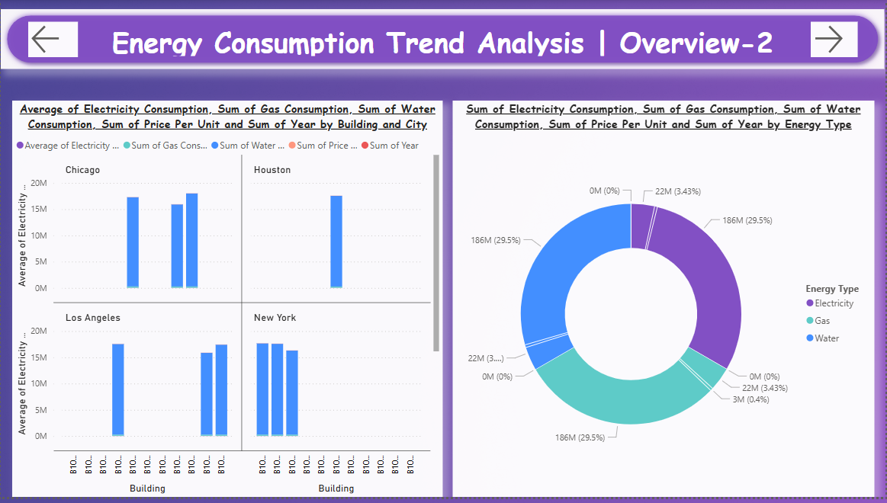
Screenshot of Output: 2) Energy Consumption Trend Analysis | Overview-2
This dashboard shows energy consumption trends for buildings in four cities (Chicago, Houston, Los Angeles, New York).
Left side: Bar charts show the average electricity use per building in each city. Los Angeles and New York have high usage across buildings.
Right side: A donut chart shows total energy type usage.
Electricity and Gas each make up 29.5% of total consumption.
Water use is very low (0.4%).
Overall, electricity and gas are the main energy sources used.

Slide 10
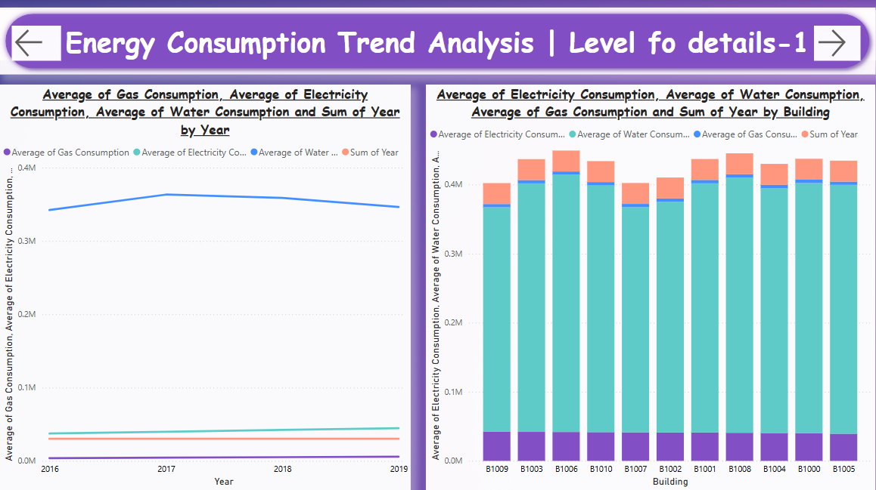
Screenshot of Output: 3) Energy Consumption Trend Analysis | Level of Details-1
Left (Line Chart): Trend by Year (2016-2019)
Electricity Consumption peaked in 2017.
Slight decline observed after 2017 across all energy types.
Water and gas remained relatively stable.
Right (Stacked Bar Chart): Building-Wise Breakdown
Each building (e.g., B1009 to B1005) is represented
Shows contributions of electricity, gas, and water
Some buildings (like B1006 and B1003) have higher total consumption

Slide 11
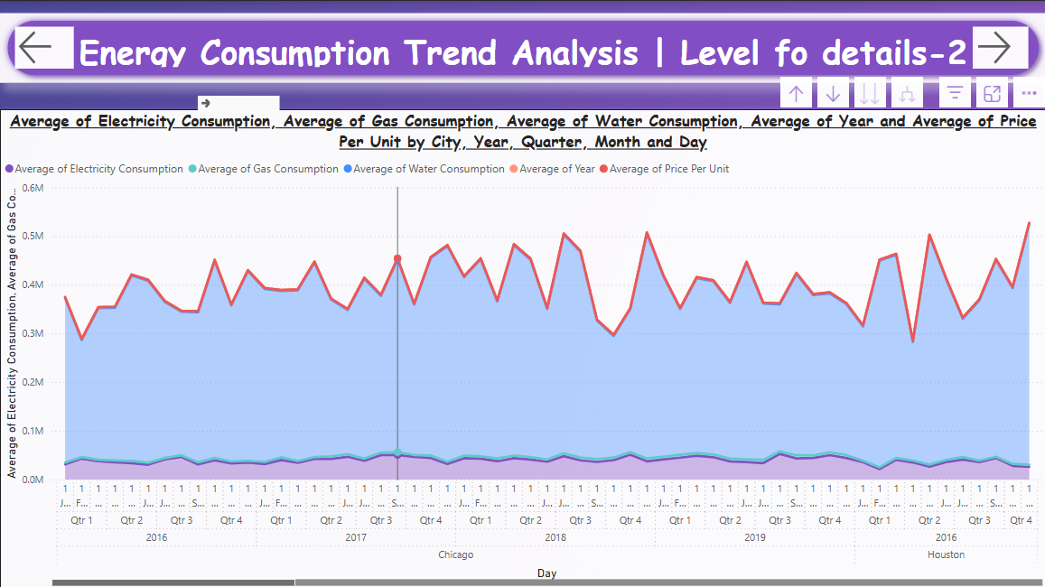
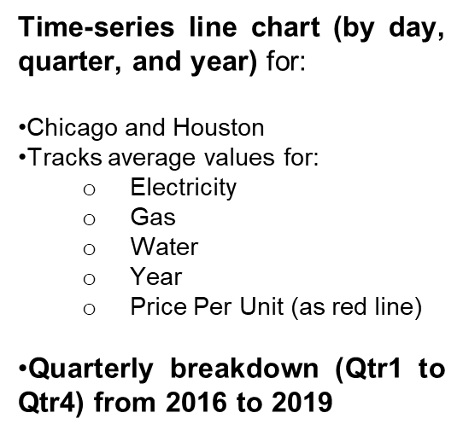
Screenshot of Output: 4) Energy Consumption Trend Analysis | Level of Details-2

Slide 12
Conclusion:
The completion of this project demonstrates how business intelligence tools like Power BI can transform raw, scattered energy data into a powerful visual narrative that supports energy optimization. Through systematic tracking and analysis:
Energy usage patterns were uncovered.
Inefficient buildings and time periods were identified.
Actionable insights were provided to reduce waste and cost.
The dashboard acts not only as a monitoring solution but also as a strategic enabler that encourages more sustainable and responsible resource usage. It bridges the gap between data and decisions, ensuring that energy management is no longer reactive but proactive and predictive.
As organizations face mounting pressure to reduce their carbon footprint and operational costs, tools like these become essential in achieving long-term environmental goals and building a smarter, more sustainable future.

